Slide 1
AutoCad 2021
د. وميض تركي محمد

Slide 2
في نهاية هذا الدرس يستطيع الطالب أن يتعرف على:
إضافة الابعاد Adding Dimensions

Slide 3
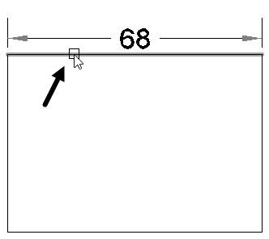
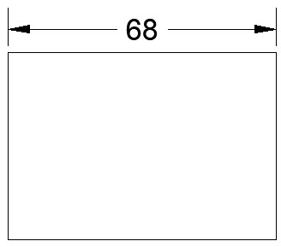
إضافة الابعاد Dimensioning
Dimensioning : In previous chapters, we learned how to draw create drawings. However, while creating a drawing, we also need to apply the size information. We can provide the size information by applying dimensions to the drawings. In this lesson, we will learn how to create various types of dimensions. We will also learn about some standard ways and best practices of dimensioning .
Creating Dimensions : In AutoCAD, there are many tools available for creating dimensions. You can access these tools from the Ribbon, Command line, and Menu Bar.
Dimension [ DIM ]: This tool is used to create the dimensions according to the entity selected.
Select a line entity, move the cursor and click to place the linear dimension, as shown.

Slide 4
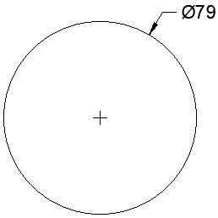
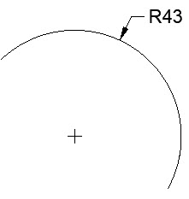
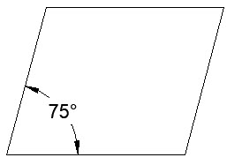
إضافة الابعاد Dimensioning
Select a circle, move the cursor and click to place the diameter dimension, as shown.
• Select an arc, move the cursor and click to place the radial dimension, as shown.
• Similarly, select two lines and place the angular dimension, as shown.

Slide 5
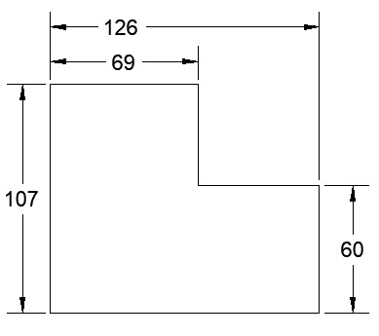
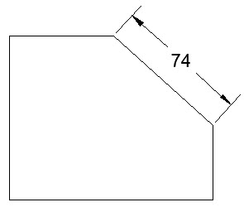
إضافة الابعاد Dimensioning
Linear [ DLI] : This tool is used to create horizontal and vertical dimensions.
• Click Annotate > Dimensions > Dimension > Linear on the ribbon.
• Select the first and second points of the dimension.
• Move the cursor in horizontal direction to create a vertical dimension (or) move in the vertical direction to create a horizontal dimension.
• Click to place the dimension.
Aligned [ DAL ]: This tool is used to create a linear dimension parallel to the object.

Slide 6
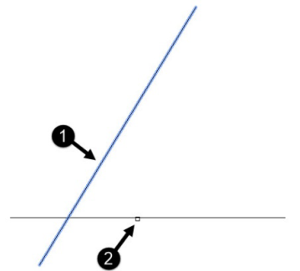
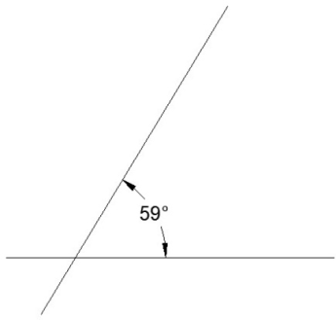
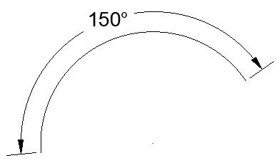
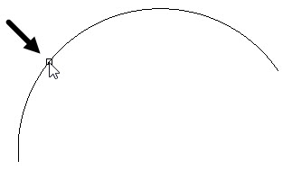
إضافة الابعاد Dimensioning
Angular [ DAN ] : This tool is used to create an angular dimension.
• Click Annotate > Dimensions > Dimension > Angular on the ribbon.
• Select the first line and second line, as shown.
• Move the cursor and place angle dimension, as shown.
• To create an angle dimension on an arc, select the arc and place the dimension.

Slide 7
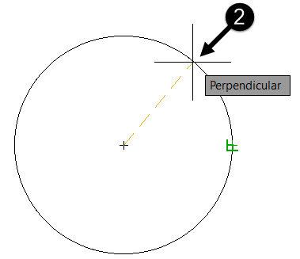
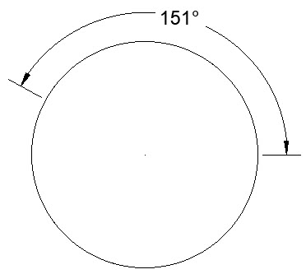
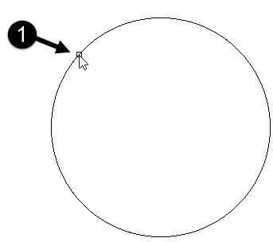
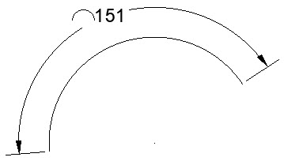
إضافة الابعاد Dimensioning
Angular [ DAN ] : This tool is used to create an angular dimension.
• To create an angle dimension on a circle, select two points on the circle and place the angle dimension, as shown.
Arc Length [ DAR ] : This tool is used to dimension the total or partial length of an arc.
• Click Annotate > Dimensions > Dimension > Arc Length on the ribbon.
• Select an arc from the drawing.

Slide 8
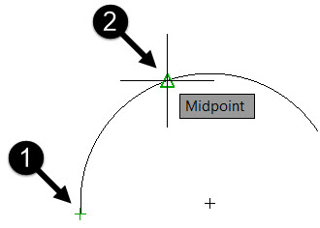
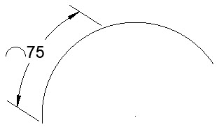
إضافة الابعاد Dimensioning
Arc Length [ DAR ] : This tool is used to dimension the total or
partial length of an arc.
• If you want to dimension only a partial length of an arc, select Partial option from the command line.
• Next, select the two points on the arc, as shown.
• Move cursor and click to place the dimension.

Slide 9
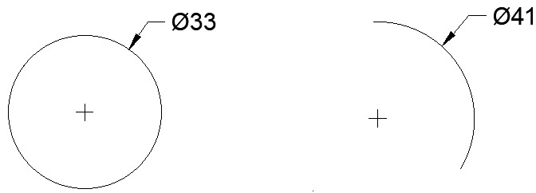
إضافة الابعاد Dimensioning
Radius : This tool is used to create a radial dimension of a circle or an arc.
• Click Annotate > Dimensions > Dimension > Radius on the ribbon.
• Select a circle or an arc and place the dimension, as shown.
Diameter [ DIA ] : This tool is used to dimension a circle or an arc, as shown.
• Click Annotate > Dimensions > Dimension > Diameter on the ribbon.
• Select a circle or an arc and place the dimension.

Slide 10
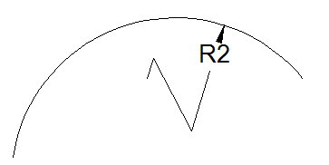
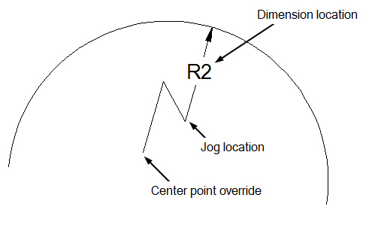
إضافة الابعاد Dimensioning
Jogged [ DJO ]: It is used to create jogged dimensions. A jogged dimension is created when it is not possible to show the center of an arc or circle.
• Click Annotate > Dimensions > Dimension > Jogged on the ribbon.
• Select an arc or circle.
• Select a new center point of the circle or arc.
• Locate the dimension and the jog location.

Slide 11
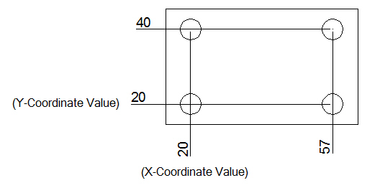
إضافة الابعاد Dimensioning
Ordinate [ DOR ] : It is used to create ordinate dimensions based on the current position of the User Coordinate System (UCS).
Click Annotate > Dimensions > Dimension > Ordinate on the ribbon.
• Select the point of the object.
• Move the cursor in the vertical direction and click to place the X-Coordinate value.
• Move the cursor in the horizontal direction and click to place the Y-Coordinate value.

Slide 12
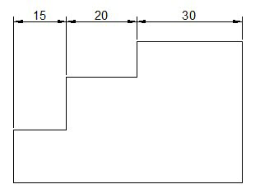
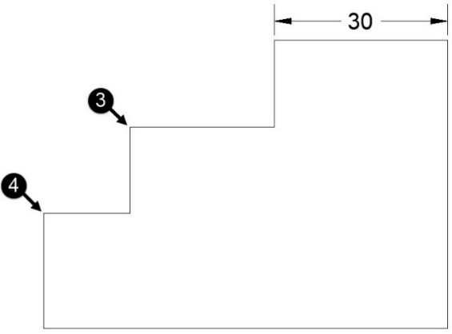
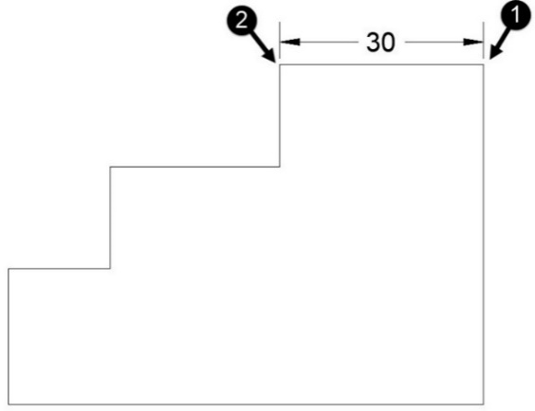
إضافة الابعاد Dimensioning
Continue [ DCO ] : It is used to create a linear dimension from the second extension line of the previous dimension.
• Create a linear dimension by selecting the first and second points.
• Click Annotate > Dimensions > Continue on the ribbon; a chain dimension is attached to the cursor.
• Select the third and fourth point of the chain dimension.
• Place the chain dimension. Next, right-click and select Enter.

Slide 13
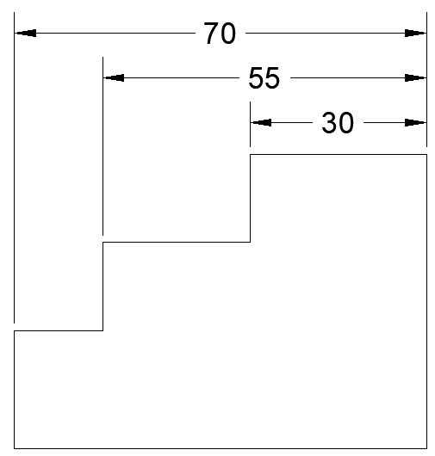
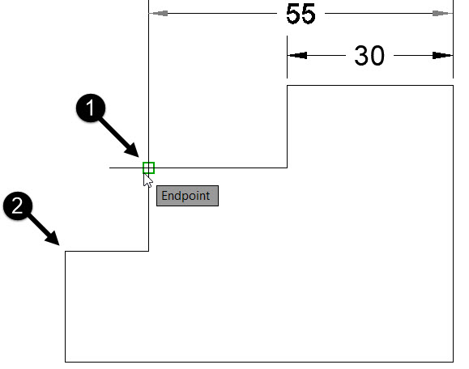
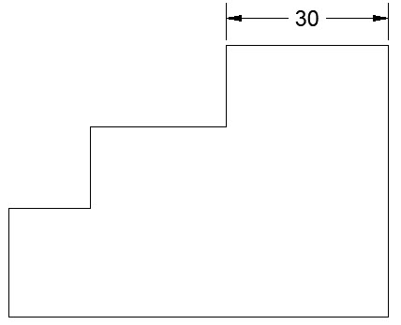
إضافة الابعاد Dimensioning
Baseline [ DBA ] : It is used to create dimensions by using the previously created dimension.
• Create a linear dimension, as shown.
• Click Annotate > Dimensions > Continue > Baseline on the ribbon.
• Select the base dimension, if it is not already selected.
• Select the other two points for the baseline dimension.
• Next, right-click and select Enter.

Slide 14
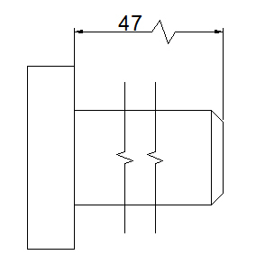
إضافة الابعاد Dimensioning
Dimension, Dimjogline [ DJL ]:It is used to create a jogged linear dimension.
• Click Annotate > Dimensions > Dimension, Dimjogline on the ribbon.
• Select the linear dimension to add jog.
• Specify the location of the jog on the dimension.

Slide 15
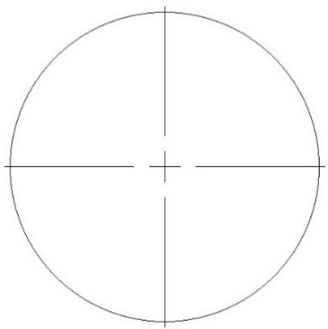
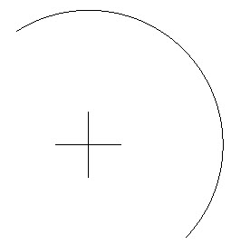
إضافة الابعاد Dimensioning
Center Mark [ DCE ] :It is used to place a center mark inside a circle or an arc.
• Click Annotate > Centerlines > Center Mark on the ribbon.
• Select an arc or a circle; the center mark will be placed at its center, as shown.
Center Line :It is used to place a center line inside an object
The following prompts are displayed.
Select First Line
Select the first of the two lines or linear polyline segments.
Select Second Line
Select the second of the two lines or linear polyline segments.

Slide 16
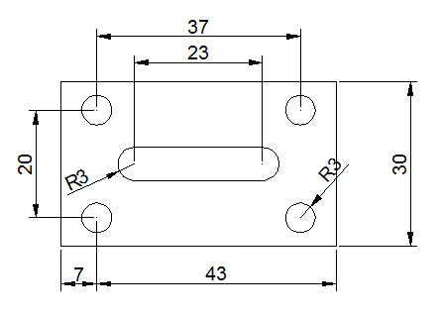
إضافة الابعاد Dimensioning
Quick Dimension [ QDIM ] :It is used to dimension one or more objects at the same time.
• Click Annotate > Dimensions > Quick Dimension on the ribbon.
• Select one or more objects from a drawing.
• Right-click and place the dimensions.

Slide 17
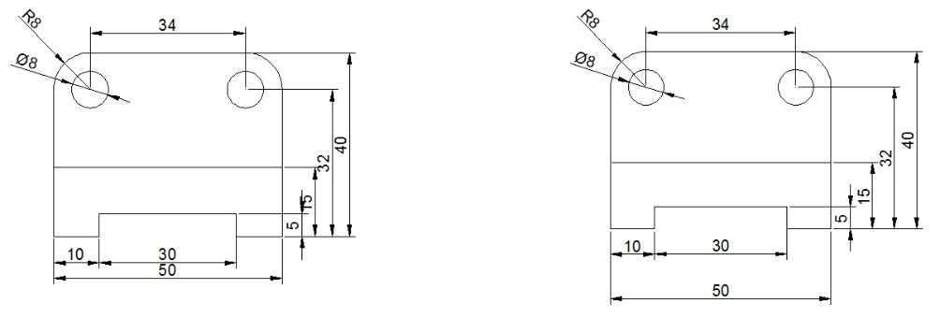
إضافة الابعاد Dimensioning
Adjust Space: It is used to adjust the space between linear and angular dimensions.
• Click Annotate > Dimensions > Adjust Space on the ribbon.
• Select the base dimension from which the other dimensions are to be adjusted.
• Select the dimensions to be adjusted.
• Right-click to accept.
• Enter the space value or select the Auto option; the dimensions will be adjusted with respect to the base dimension.

Slide 18
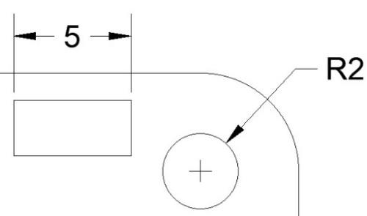
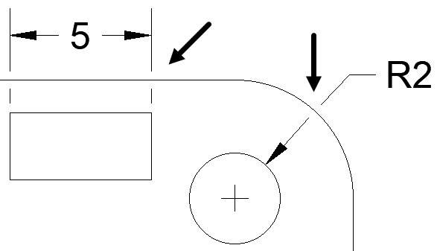
إضافة الابعاد Dimensioning
Break [ DIMBREAK ]: It is used to create breaks in dimension, extension, and leader lines.
• Click Annotate > Dimensions > Break on the ribbon.
• Select the dimension to add a break.
• Select the cutting object; the dimension will be broken by the cutting object.
• Right-click to exit the tool.

Slide 19
الدرس القادم ... AutoCAD 2021
في الدرس القادم ... إنشاء أنماط الابعاد و إضافة النصوص... بإذن الله
شكراً جزيلا

